Slide 1
RISK When depression needs professional help
Depression and the TCK in Hard Times
EuroTCK Webinar
30th April 2022
eurotck.net
Dr David Hawker Clinical Psychologist
ARREST
resilientexpat.co.uk

Slide 2
When depression needs professional help
Clinical depression
Suicidal thoughts
self-harm
Risky behaviour
Take good care of yourself!

Slide 3
Depression - more than transition
Particularly look out for
Sadness and crying
Loss of interest in friends
Problems with sleep
Anger
Violence
defiance
Self-harm
suicidal thoughts
Every day
> 2 weeks
Lost enjoyment / pleasure / motivation
Problems with eating / appetite

Slide 4
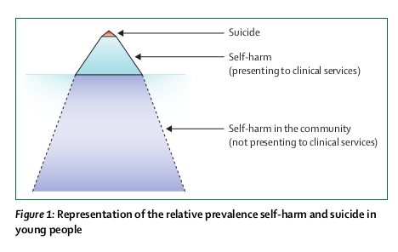
Suicide: leading cause of death in young people – but very rare
10 – 30%
https://www.thelancet.com/journals/lancet/article/PIIS0140-6736(12)60322-5/fulltext

Slide 5
Thoughts much more common
suicide
Self-harm seen clinically
Self-harm in community
Self-harm thoughts
Suicidal thoughts

Slide 6
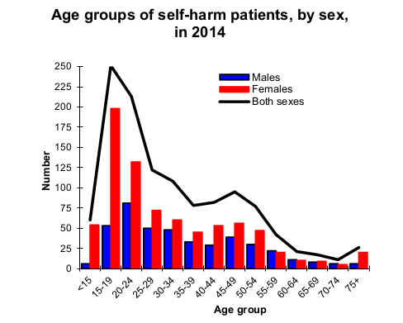
Self-harm peaks among young women
Oxford Centre for Sucide Research

Slide 7
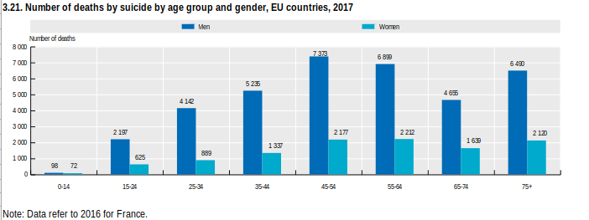
Suicide peaks among older men
https://www.oecd-ilibrary.org/social-issues-migration-health/number-of-deaths-by-suicide-by-age-group-and-gender-eu-countries-2017_911964d7-en

Slide 8
How risky?
H
A
R
M
L
E
S
S
How long have you had thoughts about wanting to hurt yourself?
Have you actually harmed yourself?
Have you recently harmed yourself?
Have you harmed yourself more than once?
Have you ever thought that life is not worth living?
Have you made any plans to end your life?
Have you ever secretly tried to end your life?
Is anyone supporting you at the moment?
See https://harmless.nhs.uk/resources/questions/ for more guidance

Slide 9
Why self-harm? What for?
Feelings too painful
Relieve tension
Feel numb
Feel something
Feel bad or worthless
self-punishment
Upset and ignored
Reach out for help
Too many problems
Feels like a way to solve problems

Slide 10
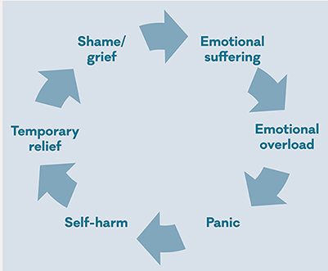
How self-harm gets worse
Methods becomes more lethal
Want to die
https://www.mentalhealth.org.uk/publications/truth-about-self-harm

Slide 11
Self-harm is not normally life-threatening...but -
Wounds & overdoses need medical attention
Risk of cutting arteries or getting infected
Small overdoses can be lethal depending on metabolism
More violent methods are more dangerous
Impulsive people are more likely to do something dangerous
Half of young people who self-harm will harm themselves again
With repetition, methods become more lethal
Increases suicide risk

Slide 12
What makes self-harm/ suicide more or less likely?
Past self-harm – self or others
Calmness
Problems with friends/ family / bullying
Tolerance for negative thoughts
Parents’ poor mental health
Strong autobiographical memory
Transgender – esp. if suppressed
Fear of pain
Past trauma / abuse
Strong faith
Drug / alcohol misuse
Reasons for living
Depression & low self-esteem
Boys (suicide)
Flexible thinking & problem-solving
Girls (self-harm)
Hope & optimism
Risk: be aware
Protection: build up
https://www.thelancet.com/pdfs/journals/lanpsy/PIIS2215-0366(14)70222-6.pdf

Slide 13
When to seek professional help
Urgently
wounds, burns, poisoning
active suicidal plans
anorexia, psychosis
moderate depression
regular & persistent self-harm persistent suicidal thoughts
bingeing & vomiting
risk to others
Yes
reactions to transition
mild & transient depression
defiance / wayward behaviour
anger / troublesome attitudes
Maybe not

Slide 14
How to get professional help
Psychiatrist – clinical psychologist -
child psychotherapist –
mental health professional - family doctor
Who from?
Can you trust them?
check regulation
healthregulation.org
GP surgery / A&E / ER
CAMHS / private practice
Skype / Zoom
Where?
CBT (cognitive-behavioural therapy)
DBT (dialectical behaviour therapy)
Mindfulness - Medication
ACT (acceptance & commitment therapy)
Emergency assessment
What treatment?

Slide 15
Overcoming obstacles
Could be persuaded?
Limited options without consent
Does young person want help?
Seek help from state or private system?
Consider quality & accessibility
Is suicide illegal or self-harm shameful?
Consider how to make treatment safe & acceptable
Is remote treatment legal?
Check with practitioner

Slide 16
What if they don’t want help?
Has to be the right time for them...
...sometimes you have to wait
Has to be the right person…
….need to find someone they trust and connect with
Has to be help for the right problem…
...parents might see one problem and the child another
Maybe they’re not sure…
...but might give it a try
If their life is in danger…
...they may have no option
Options for self-help

Slide 17
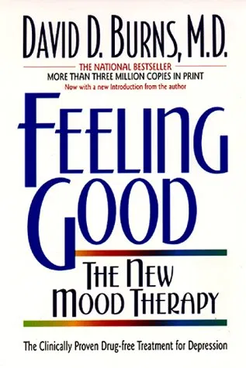
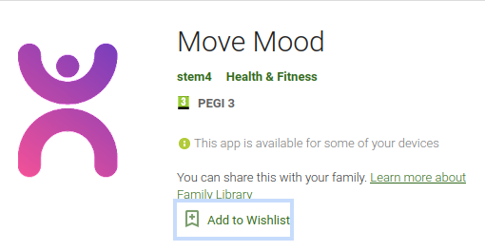
Self-help for depression

Slide 18
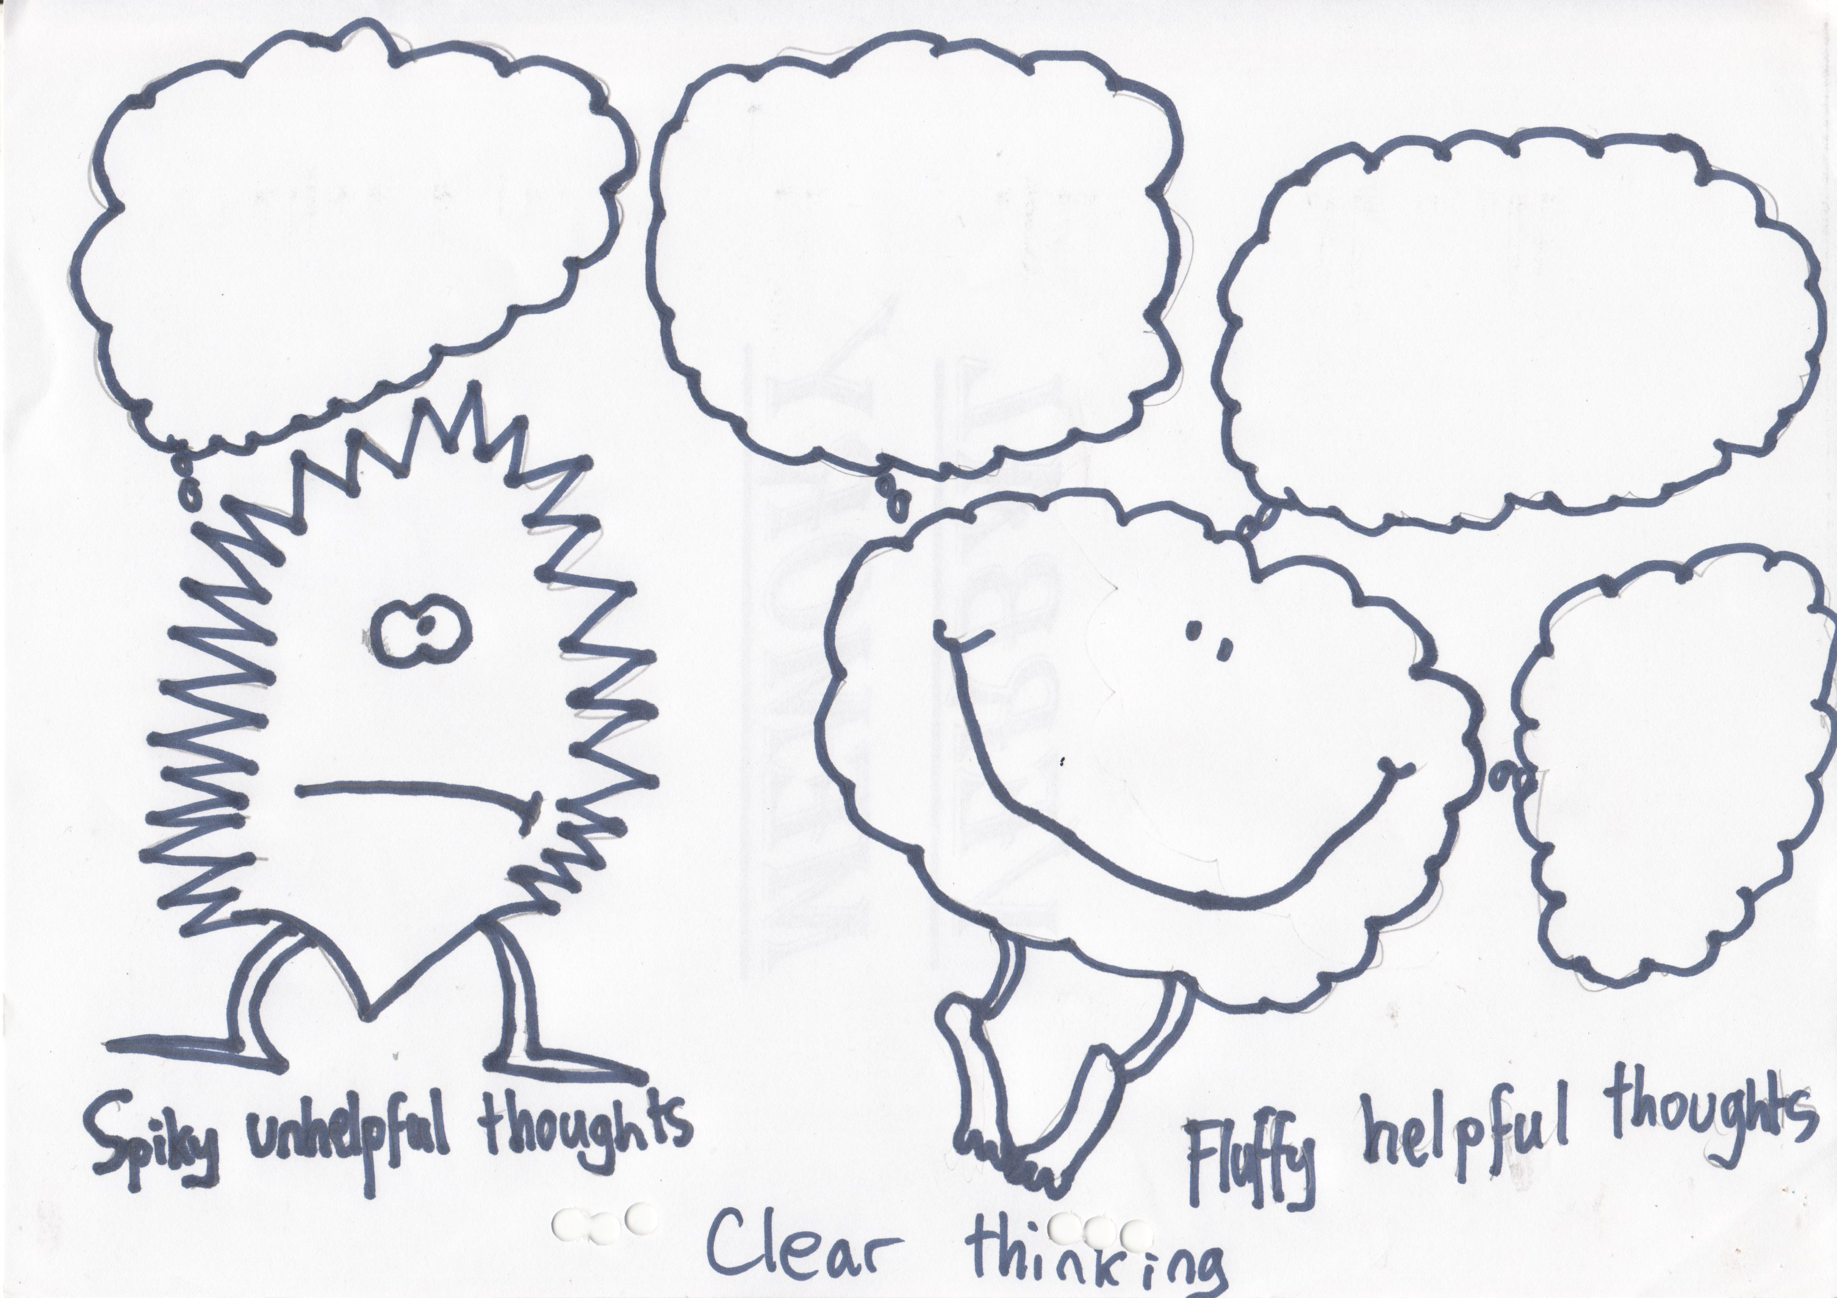
CBT: Clear thinking
Negative thoughts | Belief | Alternative rational thought | Rerate belief in negative thought
Nobody loves me | 100% | Mum and Dad say they love me | 50%
From Creative Therapy – Angela Hobday

Slide 19
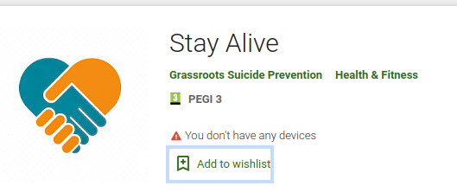
Self-harm: safety plans
Make in advance
for use in crisis
Agree with young person &
Involve friends & family
Safe place
Reasons to live
Remove access to methods self-harm – or make it safer
Trusted contacts for support
Plan activities for distraction /
lifting mood / calming

Slide 20
Working out what self-harm is for: Find the triggers
Especially if children too young or inarticulate to describe triggers themselves: STAR chart
Date / time | Setting Where, who present, what else going on | Trigger What happened immediately before | Action What child did | Results What happened next & how ended

Slide 21
Anticipating and overcoming urges to self-harm
Thoughts
Body sensations
Feelings
Mood diary
Behaviour:
What can you do instead?

Slide 22
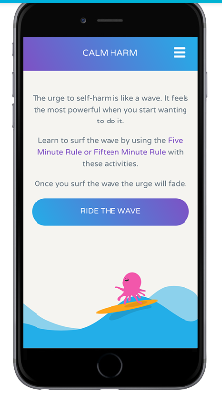
Finding alternatives to self-harm
A list of alternative activities can help young people ‘ride the wave’ of’ their urge to self-harm
What works depends on the feelings the child is trying to manage and what self-harm does for them
Match the activity to the function
Young people may need help to decide (using problem-solving) but need to make own choices

Slide 23
Problem-solving alternatives
Option | Is it possible? | Is it safe? | Is it fair? | Will it lead to good feelings?

Slide 24
Match activity to function
Exercise vigorously - punch cushion – rip paper – squeeze stress ball – make noise
Relieve tension
Feel something
Create strong sensations – cold shower, ice cube, chilli, loud music
Short-term only: red pen/ rub ice cubes / snap rubber bands
self-punishment
Reach out for help
Use trusted contacts
Feels like a way to solve problems
Structured problem-solving

Slide 25
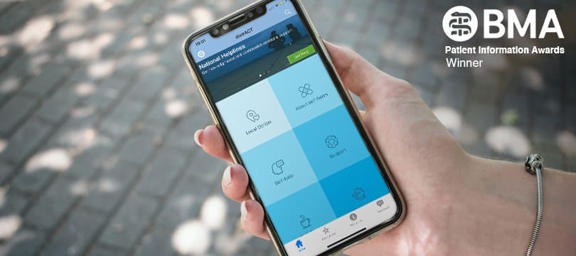
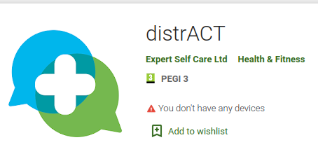
See distrACT app for more ideas for distraction & substitution

Slide 26
Online & remote resources
International helplines
https://www.befrienders.org/
https://www.iasp.info/crisis-centres-helplines/
Self-harm & suicide prevention
https://harmless.org.uk/
https://harmless.nhs.uk/
https://www.nshn.co.uk/
https://www.psych.ox.ac.uk/files/news/copy_of_coping-with-self-harm-brochure_final_copyright.pdf
https://www.selfharm.co.uk/

Slide 27
Depression moodgym.com.au
Sleep mysleepwell.ca/cbti/
Eating disorders https://www.beateatingdisorders.org.uk/
Overcoming binge eating https://www.credo-oxford.com/6.1.html
Christian approach to mindfulness shaunlambert.co.uk
Drugs & alcohol https://www.talktofrank.com/
Porn addiction https://www.safersurfing.org/loveismore-en/
General resources for children and mental health
https://www.camhs-resources.co.uk/
https://www.annafreud.org/on-my-mind/self-care/
https://www.resilientexpat.co.uk/links.html
https://www.youngminds.org.uk/
https://www.aacap.org/AACAP/Families_and_Youth/Facts_for_Families/Layout/FFF_Guide-01.aspx
https://www.rcpsych.ac.uk/mental-health/problems-disorders/self-harm
https://www.helpguide.org/articles/anxiety/cutting-and-self-harm.htm
careforthefamily.org.uk

Slide 28
5 questions to ask about risk
Who is in danger of getting hurt?
How could they get hurt?
How high is the risk?
What can you do to prevent it?
What do you need a professional to help with?

